Slide 1
Time-Series Forecasting

Slide 2

What you will Learn
What is Time Series Forecasting?
Analyzing Time Series data.
Smoothing Techniques.
Auto Regressive Techniques.

Slide 3
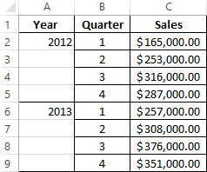
What is Time Series data?
Time Series is simply a series of data points that has a time component involved in it.
Every data point present in the dataset is associated directly with the date and time component.

Slide 4

Example of Time series
We have to predict the number of customers visiting the restaurant each day to manage staffing and other requirements accordingly.

Slide 5
How can Time series be Helpful?
Forecasting can help the restaurant serve their customers in a better way.
Forecasting can help the Restaurants prepared for the upcoming Demands and requirements.

